Slide 1

MATH 132
Lesson 1: Order of Operations Exercise

Slide 2
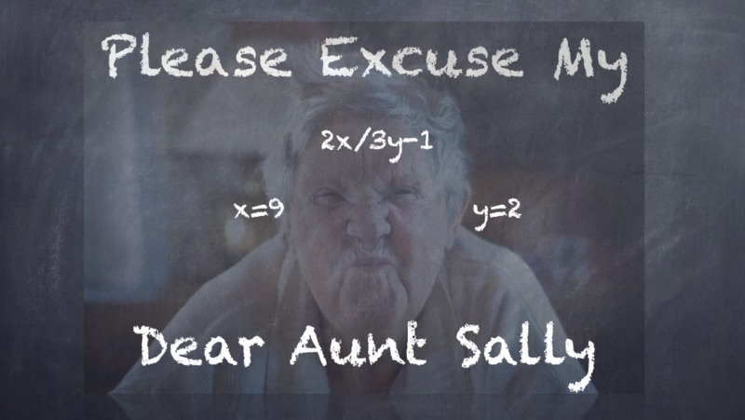
What do you call it?
Order of Operations in the World
BODMAS - PEMDAS - PODMAS

Slide 3
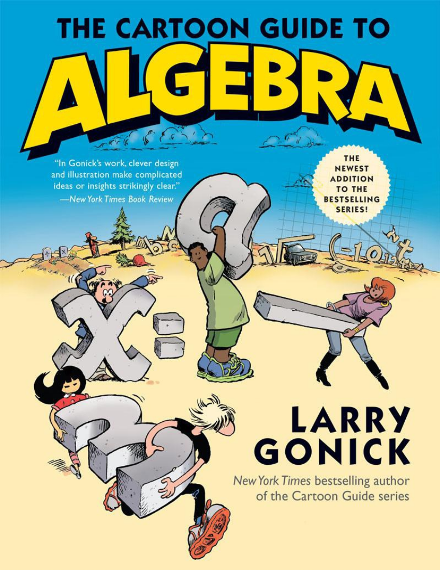
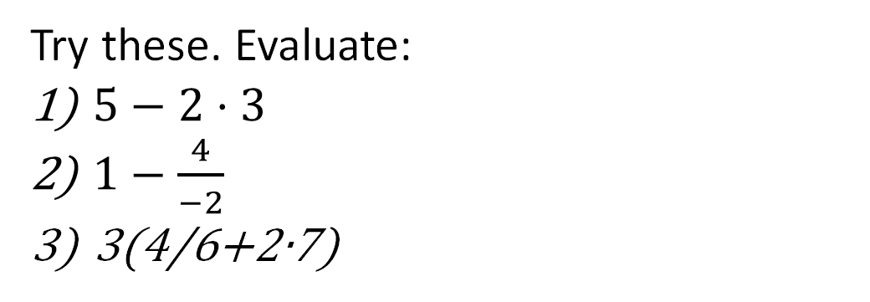
Ghastly
(10+((((1+2)+(3x4))-9)+(7x8)))/9
Order was established and the above expression could be cleaned up
(10 + 1 + 2 + 3x4 – 9 + 7x8) ÷ 9
Try these. Evaluate:
$5−2⋅3$
$1−\frac{4}{−2}$
3(4/6+2∙7)
Answers: 1) -1
2) 3
3) 44

Slide 4
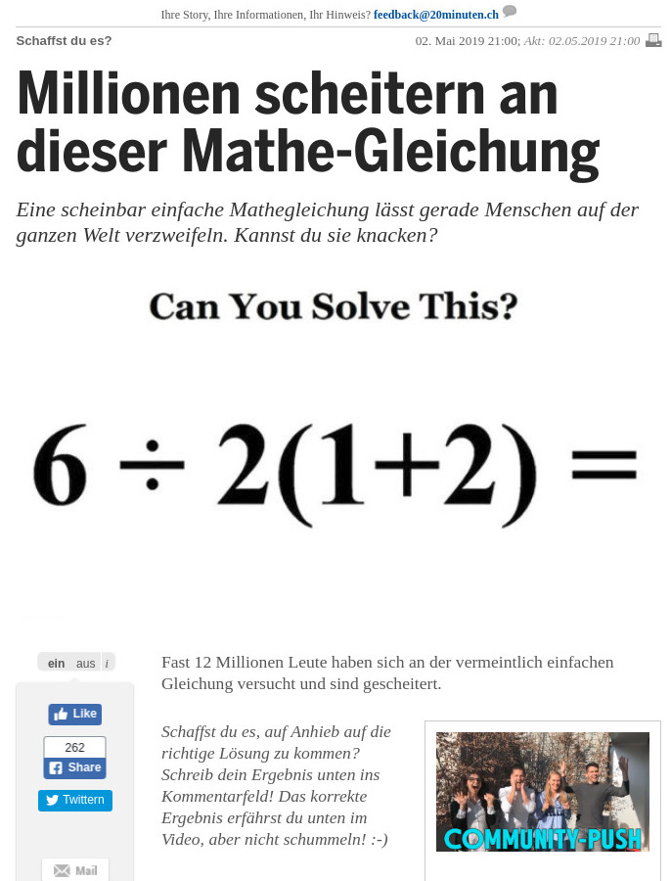
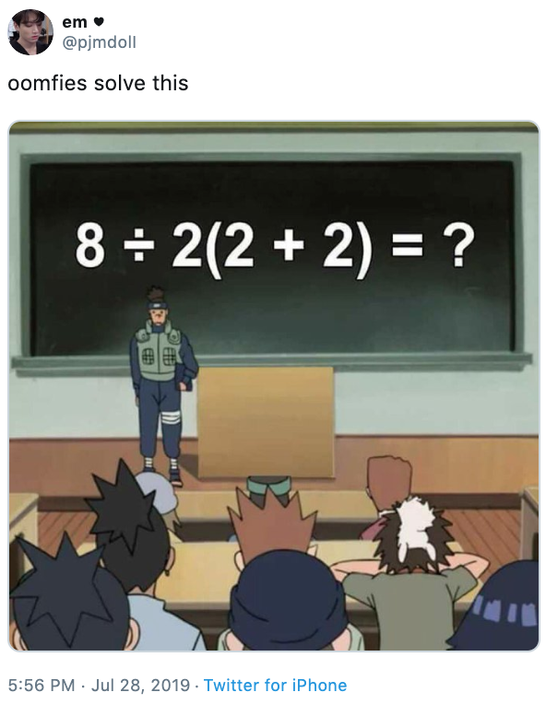
How the internet responded - "thread wars"
Left: Some said the answer was 9. Others insisted on 1.
Right: Some said 16 while others defended a result of 1.
What exactly is the issue? Could there be room for both interpretations?

Slide 5
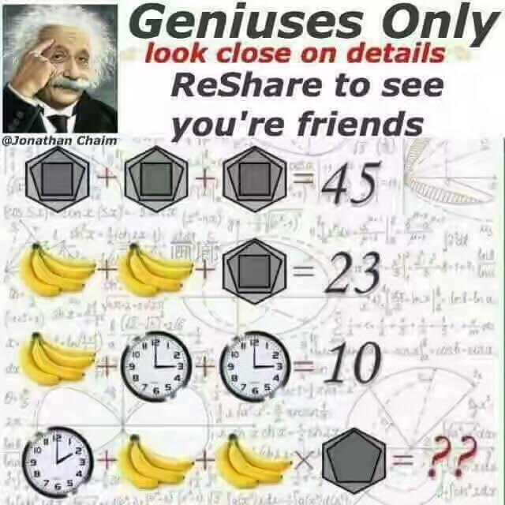
A lot of math is about perception and detail in the use of symbols
The answer to the problem on the bottom row is:
38

Slide 6
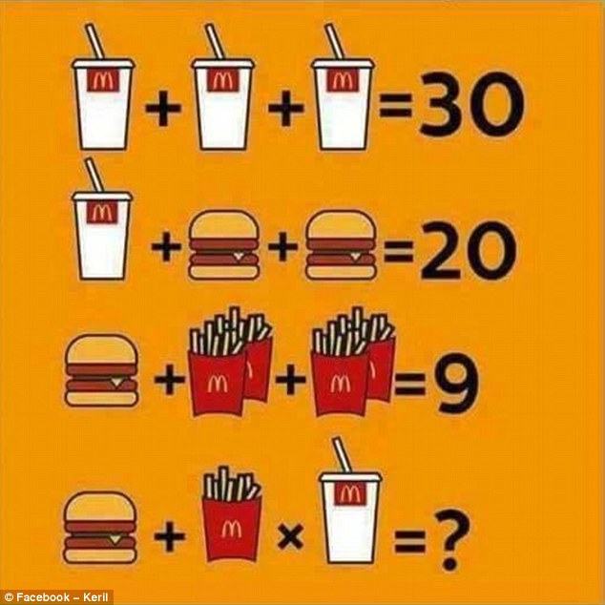
What is the answer to the problem on the bottom?
The answer is:
15
There can be a wide variety of symbols we use to indicate multiples of something. The adoption of our base-10 numeral system worldwide took centuries, and even now some still have two mathematical languages: one for science and commerce and the other for sacred applications.

Slide 7
Additional Reading
Article about PEMDAS, BODMAS
Open Textbook – The Hindu-Arabic Number System
First link: https://byjus.com/maths/pemdas/

Slide 8

Goal: Use Multiple Representations To Solve a Math Problem
Description: What is the relationship between time (t) and interest (I) in a simple interest situation if the annual interest rate is 4% (or 0.04) and the amount borrowed (P) is $200? Also, it is known that Interest (I) is given by the formula I = Prt
Equation: Start with I = Prt
t = x | I = y
0
1
 | 40
12
Table:

Slide 9
MATH 132 Day 1 Activity Instructions
Make a graph of the relationship between time (t=x) in years and interest (I = y) in $. Label the axes. I is on the vertical, t is on the horizontal. Use the fact that the Interest formula is: I = Prt
You may simplify the formula and write an equation using y = f(x) notation. Time (t) is going to be “x” and Interest (I) is “y”.
Fill in the table with the missing values
Exit ticket questions:
Is this a function? If the loan period is 15 years, what is the domain? What is the range? Is the equation linear? If so, what are the slope and y-intercept? What is the monthly payment?

Slide 10
Goal: Use Multiple Representations To Solve a Math Problem
SOLUTION
Equation: Start with I = Prt Change “t” to “x” and “I” to f(x) and we have: f(x)= Prx
Graph:
Simplify: P = 200 and r = 0.04
200 times 0.04 = 8
The equation becomes: f(x) = 8x OR y = 8x
96
72
56
40
24
8
Table of
Values:
t=x | I=y
0 | 0
1 | 8
5 | 40
12 | 96
1 3 5 7 9 12

Slide 11
MATH 422 Day 1 Activity Instructions
SOLUTION
Exit ticket questions:
Is this a function? YES… there is one value of y for every x
If the loan period is 15 years, what is the domain? Answer: 0 to 15 years (the x interval of time)
What is the range? Answer: y goes from 0 to 120 during the time from 0 to 15 years (total interest is $120)
Is the equation linear? YES
If so, what are the slope and y-intercept? Slope = 8, y-intercept = 0
What is the monthly payment? In 15 years, there will be 180 payments. 200 + interest = $320 Monthly payment will be 320 divided by 180 = $1.78

Slide 12

Math 132
Lesson 1 Average Rate of Change
(Using Excel to graph (x,y) from data)

Slide 13
Objective: How to Get the Most Out of Your Textbook
Before next class you should have read the portion of the textbook in the first module
Make index cards of concepts in boldface print
On paper, work through any examples and ‘Try This’
Youtube.com/@EZMathTV videos are there to support your learning of the material.

Slide 14
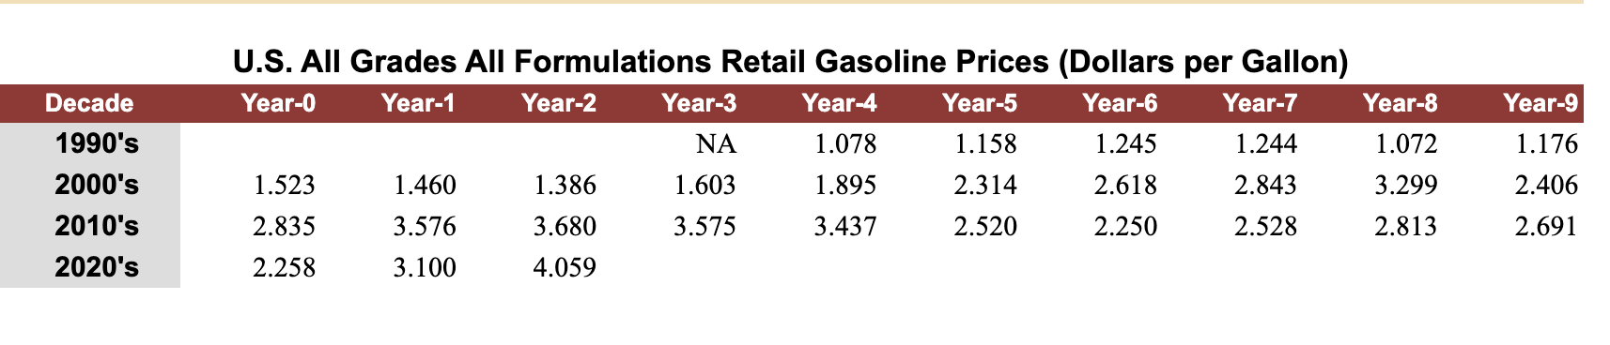
Gas Prices in the United States: Getting the most out of Excel
Get real data
Put it in Excel
Source: eia.gov

Slide 15
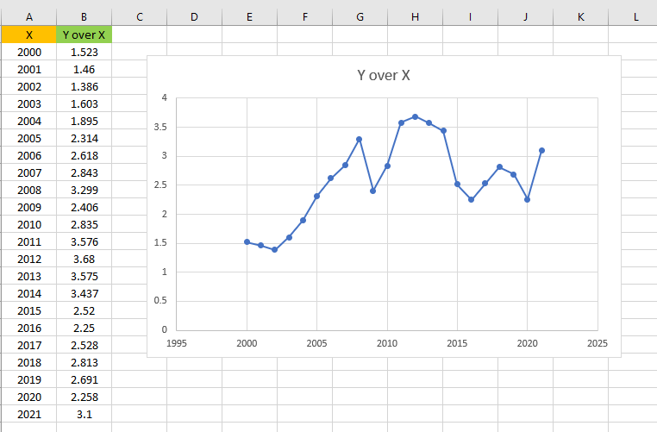
Scatter Plot with Markers

Slide 16
Average Change in Gas Prices from 2000 to 2022
Using the formula on the bottom of page 19:
Average rate of change = (4.059-1.523)/(2022-2000)
Simplified to 2.536/22
Which is +$0.1153

